Slide 1
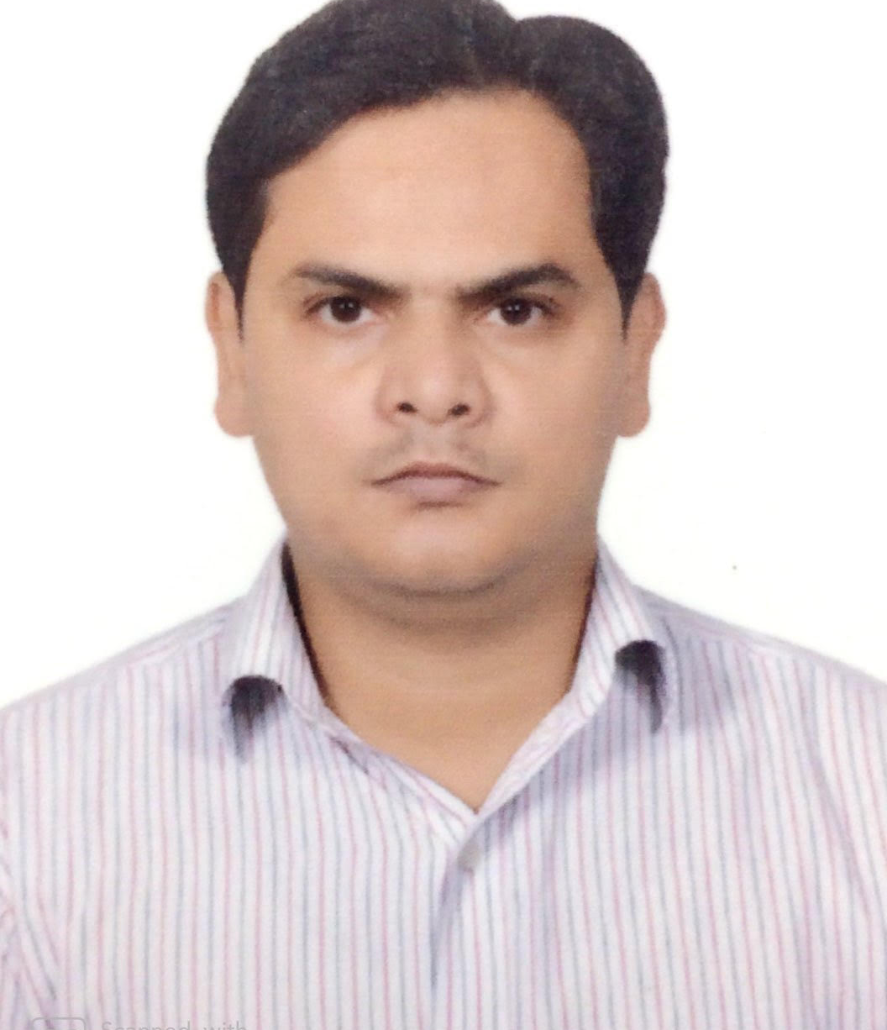
Lead Developer
Ram Prakash Singh
Lead Developer
ram.prakash.singh@accenture.com
+91 9953875097
Business On Line(Corporate banking) – Bank Of Ireland Client. Location: Ireland.
Delivery lead for Corporate Banking web application for scrum team. Agile software develoment methodology. Tech stack such as Java, Spring, Oracle, Coolgen, Mainframe.
Machine to Machine – Yanmar Agriculture Equipment Client . Location: Japan & India.
Delivery lead for Cloud based application for scrum team. Agile software development methodology. Tech stack Java, AWS(IOT, Kinesis, Lambda, EC2, S3, DynamoDB), Docker etc.
Learning Objective Management Tool – Pearson Client. Location UK & North America.
Lead and Sr. Engineer for microservices application analysis, design and development. Tech stack such as Java, Microservices, SpringBoot, RDF, MarkLogic DB etc.
Socrates - Specsaver Optical Group Ltd Client. Location UK, Australia, Nederland
Part of Product development scrum team, Tech stack such as Java, Spring, Hibernate, SOAP WS etc. Agile software develoment methodology.
10 years experience in design and implementation of web application, object oriented, frameworks & cloud architecture in various business domains.. Experienced in managing, leading development & integration projects, test and business driven development, product development.
Experienced in microservices, monolithic, SAML applications, Java, AWS, Docker, open-source technologies such as spring/spring boot, application servers, version control, build and deployment tools, SQL/NO-SQL databases, UI(JavaScript,JQuery) tech stack. Trained in reactive programming
Java
SpringBoot
REST
Microservice
SOAP
Hibernate
AWS(Lambda, IOT, Kinesis, S3, Dynamo & Aurora DB, API gatway, CI/CD etc)
Docker
SQL/No-SQL DB
Selenium
Junit
Retail
Banking & Mortgage Insurance
Publishing
Manufacturing(AWS IOT)

